Slide 1
THREADS
REFERENCES:
“OPERATING SYSTEM CONCEPTS” 9TH EDITION BY ABRAHAM SILBERSCHATZ, PETER BAER GALVIN AND GREG GAGNE
“OPERATING SYSTEMS: INTERNALS AND DESIGN PRINCIPLES”, 7TH EDITION BY WILLIAM STALLINGS
“INTRODUCTION TO OPERATING SYSTEMS ”, BY PROF. CHESTER REBEIRO (HTTPS://NPTEL.AC.IN/COURSES/106/106/106106144/)

Slide 2
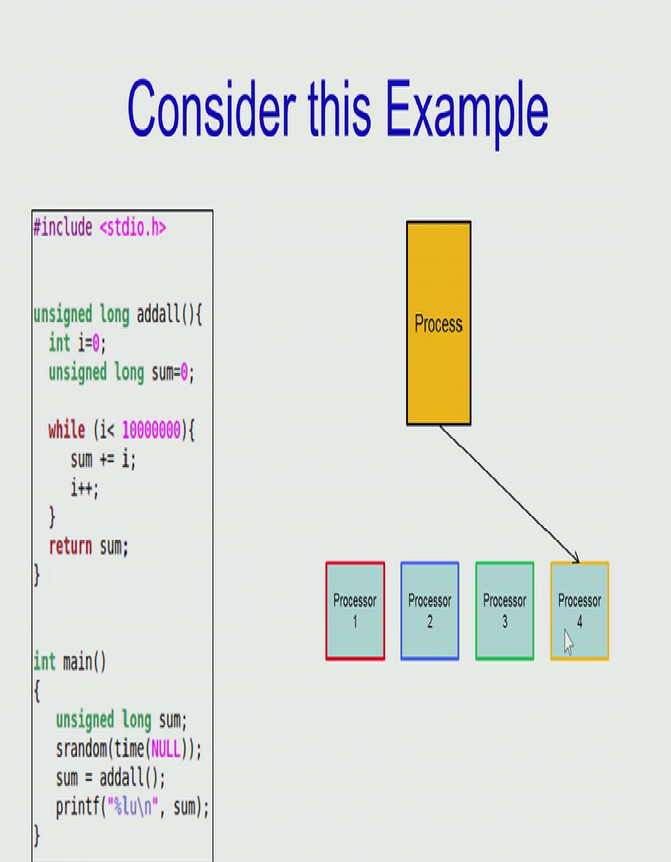
CONSIDER THE FOLLOWING SCENARIO:
There are 4 CPUs in the system
The given program is adding numbers upto 10 million using
an addall() and executing the process in one CPU.
Problem: Other processors are not utilized and single process
takes long time to complete execution
Ref. 3

Slide 3
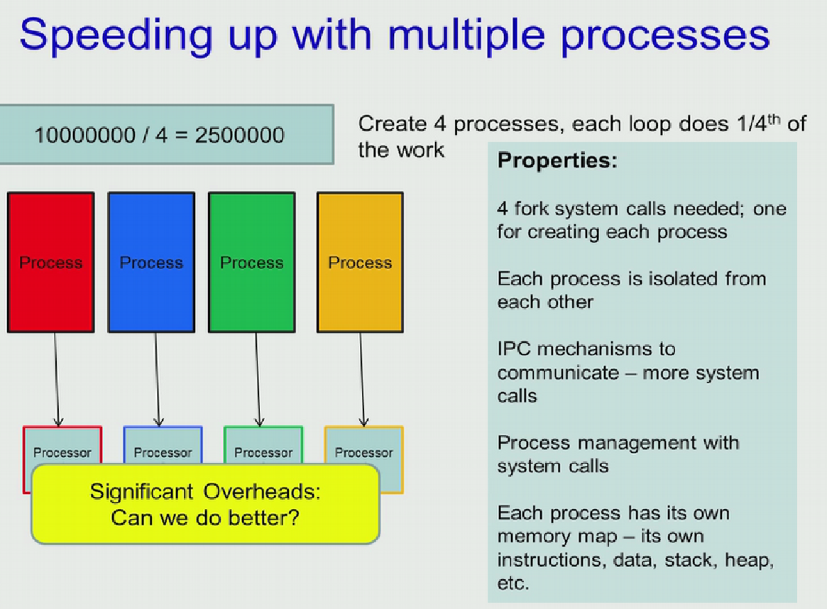
What can be the better method to perform this summation?
Create 4 processes such that each process adds 2.5 million no.s
We need 4 fork() calls to create 4 processes
Each process can execute in one processor
Reduces the computation time,
But
Each process has its own set of instructions, data, heap and the stack
A large portion of these 4 processes are similar.
A lot of duplication of instructions and data
Process Management and IPC required
Ref. 3

Slide 4
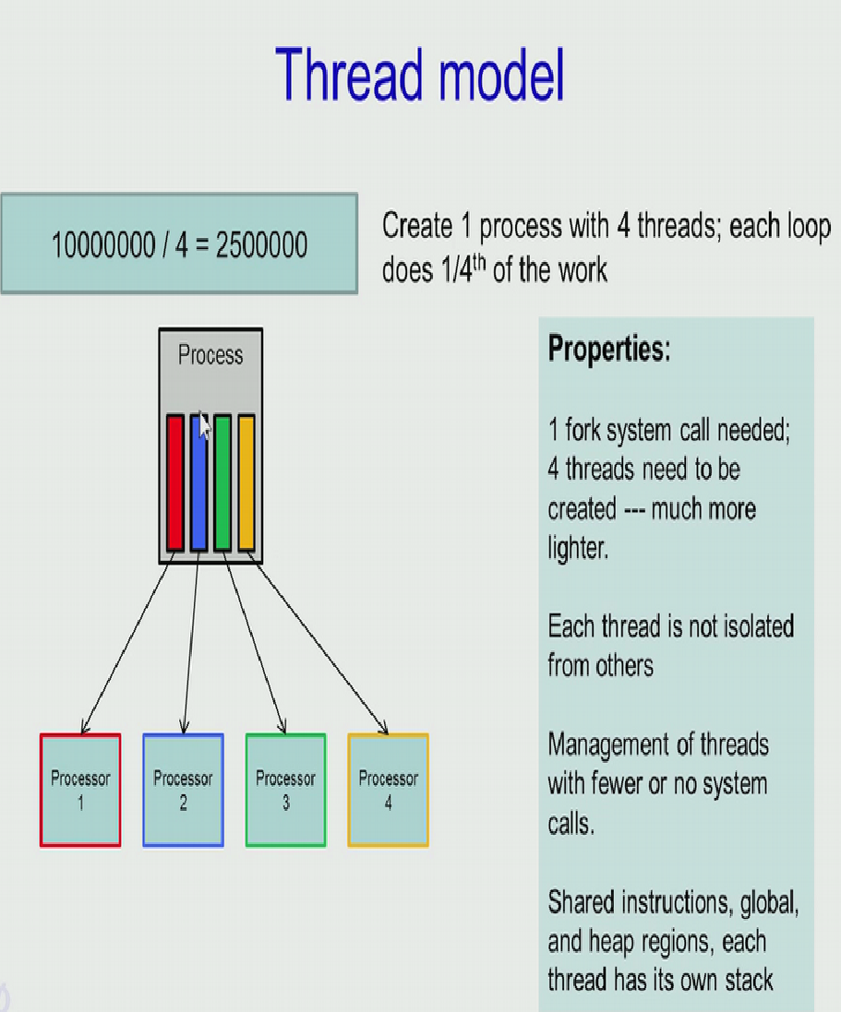
Any better method to reduce this overhead and achieve parallelization?
Create 4 threads under 1 process, using Pthread.
Each thread executes in separate processor
Each thread shares common instructions, parameters and heap, etc.
However, each thread has separate stack.
Each thread will add 2.5 million no.s
Threads are lighter than processes
Very few or no system calls needed to create threads
Ref. 3

Slide 5
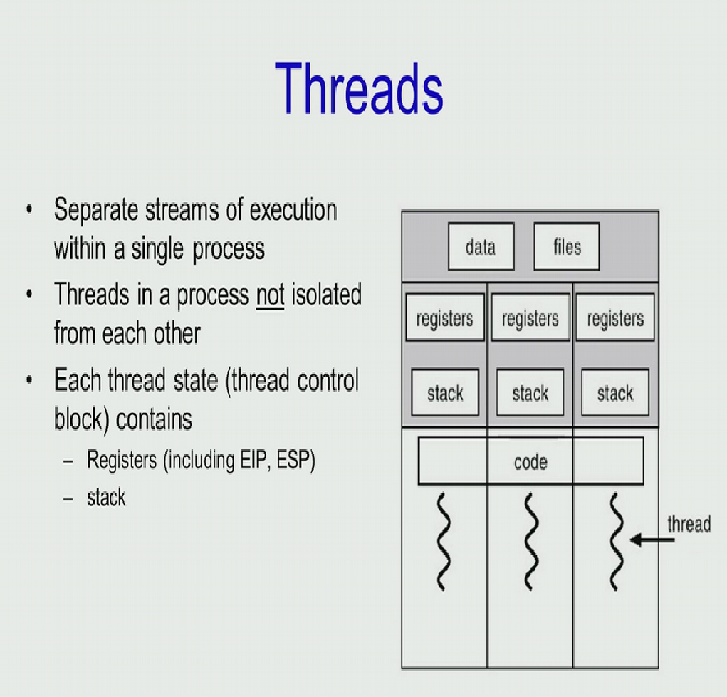
Threads
Threads are separate streams of execution within a single process.
They are not isolated from each other.
The state of a thread is stored in Thread Control Block which contains registers and stack
It provides mechanisms to perform multiple tasks concurrently.
Each thread has got associated:
Thread ID
Program counter
Register set
Stack
Ref. 1

Slide 6
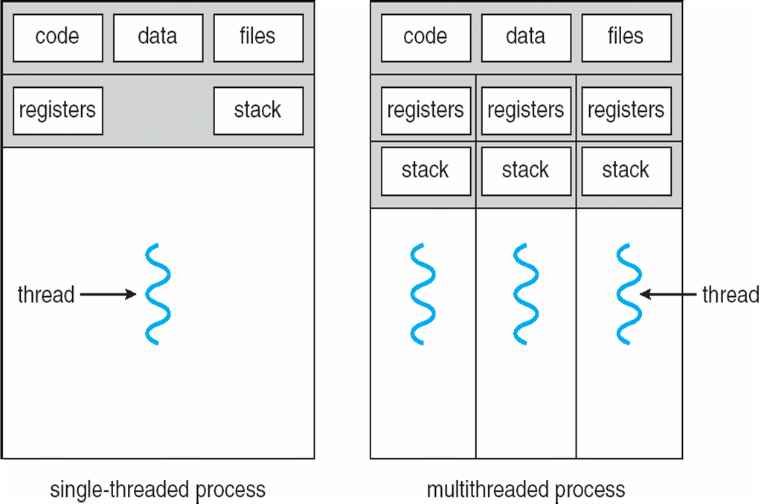
SINGLE AND MULTITHREADED PROCESSES
heavyweight process
lightweight process
Ref. 1

Slide 7
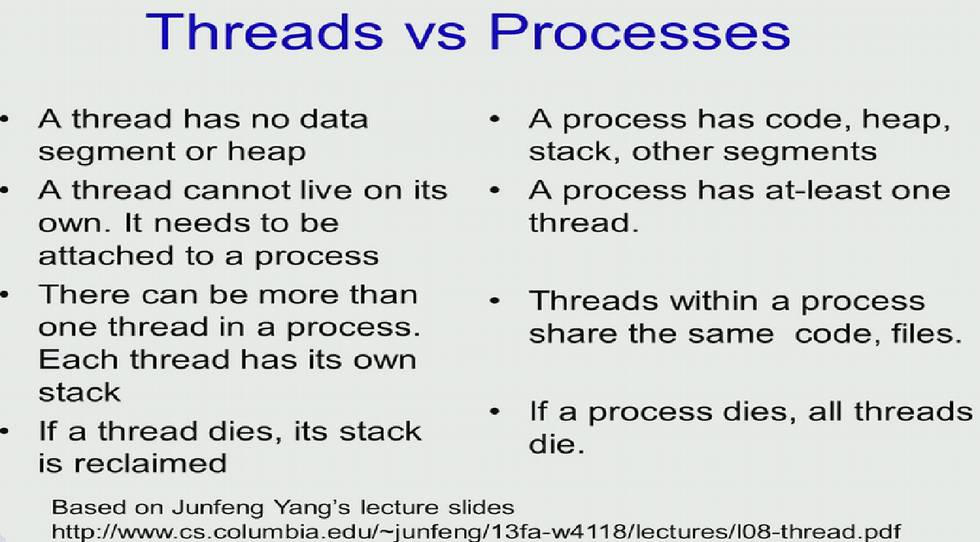

Slide 8
MERITS OF USING THREADS
Threads can be created and destroyed quickly as compared to processes
Applications can use threads to execute some functions in the background
Threads can share the same address space.
It takes less time to switch between threads due to smaller state record

Slide 9
THREADS SCHEDULING
Threads are scheduled to execute in CPU independently
State of each executing thread is maintained separately.
If a process is suspended, then all its threads are suspended
If a process is terminated, then all its threads are terminated
A thread also has states like ready, running, waiting or blocked.

Slide 10
TYPES OF THREADS
User Level Thread (ULT)
Kernel level Thread (KLT)
NOTE: We are talking about threads for user processes. Both ULT & KLT execute in user mode. An OS may also have threads but that is not what we are discussing here.

Slide 11
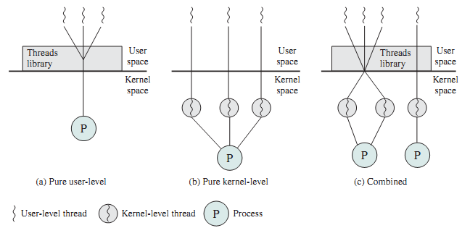
THREADS MANAGEMENT
User-Level Threads (ULTs)
Managed by applications and user level thread library
Kernel is not aware of these threads
Kernel-Level Threads (KLTs)
These are created and managed by kernels
Also called as light weight process
Ref. 1

Slide 12
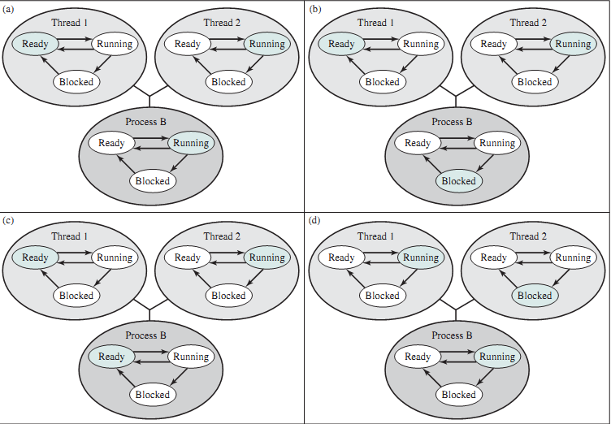
Relationships Between ULT States And Process States
Ref.2

Slide 13
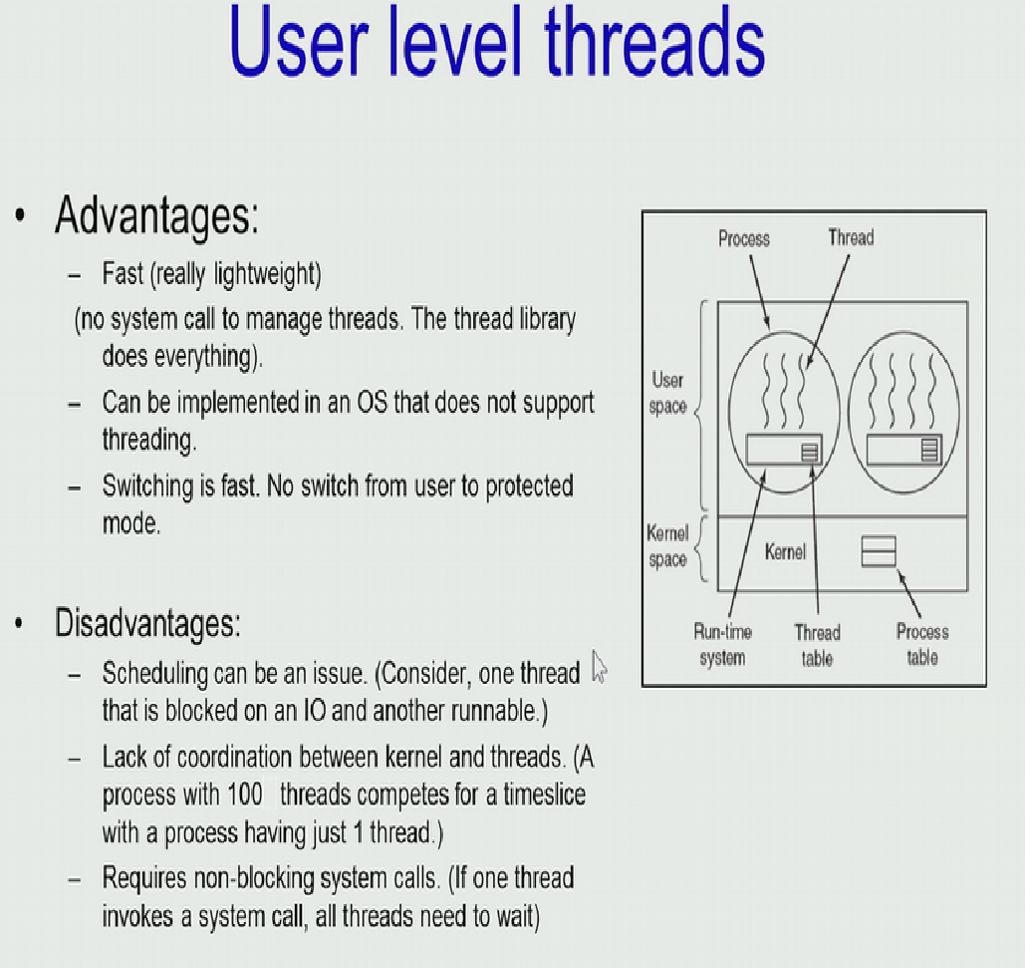
MERITS AND DEMERITS OF ULT
It can be implemented in OS that does not support threading
Fast creation and switching
Does not need System call
Process with many threads also competes with a single threaded process
Scheduling decisions cannot be made to favour processes with the larger number of threads
If one thread makes system call then all others get blocked
Solution: JACKETING
converts a blocking system call into a non-blocking system call
Ref.2

Slide 14
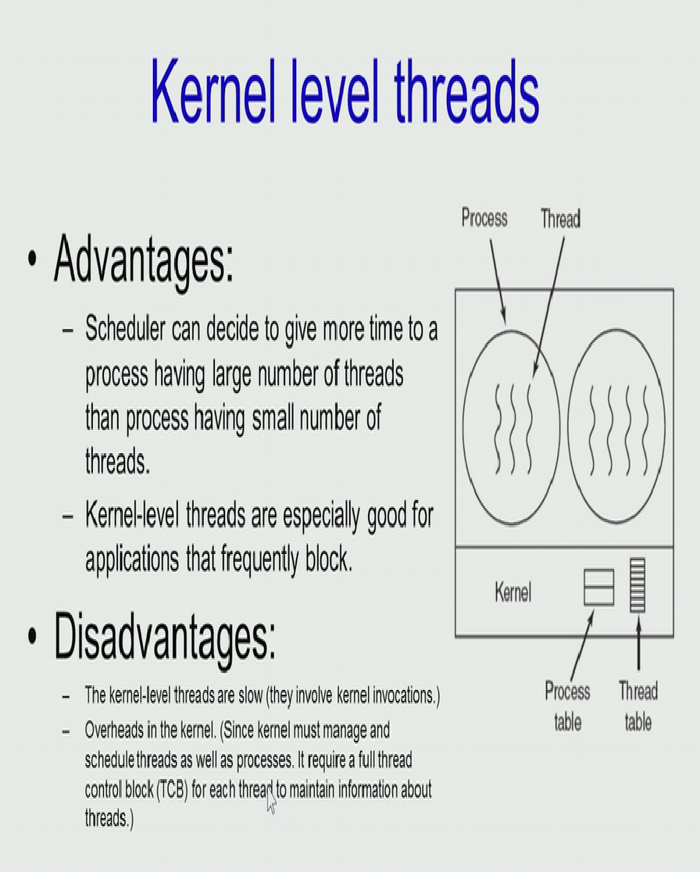
MERITS AND DEMERITS OF KLT
Thread table is stored in kernel space. Hence, kernel knows about no. of threads a process has
OS can provide more time quantum to a process with large no. of threads
Better to use for application that frequently blocks
One thread making system call does not block others
Slow
Larger overhead due to kernel level management
The transfer of control from one thread to another within the same process requires a mode switch to the kernel
Ref.2

Slide 15
MULTITHREADING MODELS
One-to-One
Many-to-One
Many-to-Many

Slide 16
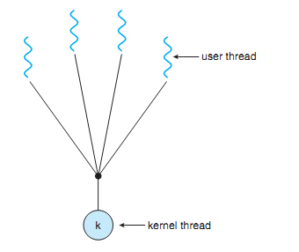
MANY-TO-ONE
Many user-level threads mapped to single kernel thread
Ref.1

Slide 17
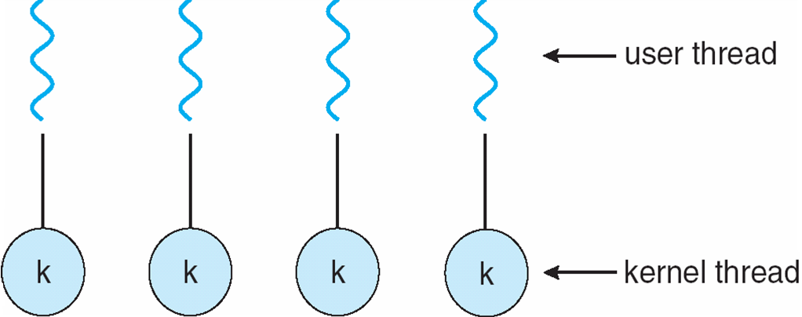
ONE-TO-ONE
Each user-level thread maps to kernel thread
Examples
Windows NT/XP/2000
Linux
Ref.1

Slide 18
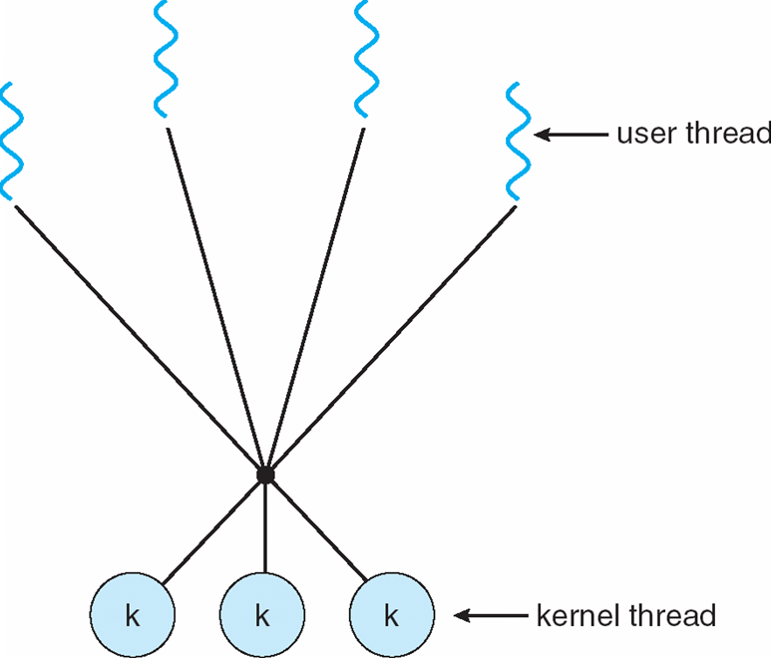
MANY-TO-MANY MODEL
Many user level threads are mapped to many kernel threads
It allows the operating system to create a sufficient number of kernel threads
Example
Windows NT/2000
Ref.1

Slide 19
THREAD LIBRARIES
It provides programmer with API for creating and managing threads
Two primary ways of implementing
Library entirely in user space
Kernel-level library supported by the OS
Three main thread libraries in use today:
POSIC Pthreads
Win32
Java

Slide 20
POSIX
It can be used over Linux systems
Pthreads API must be compiled with –pthread or –lpthread
#include <pthread.h>
pthread_t pthread_self()
returns : ID of current (this) thread

Slide 21
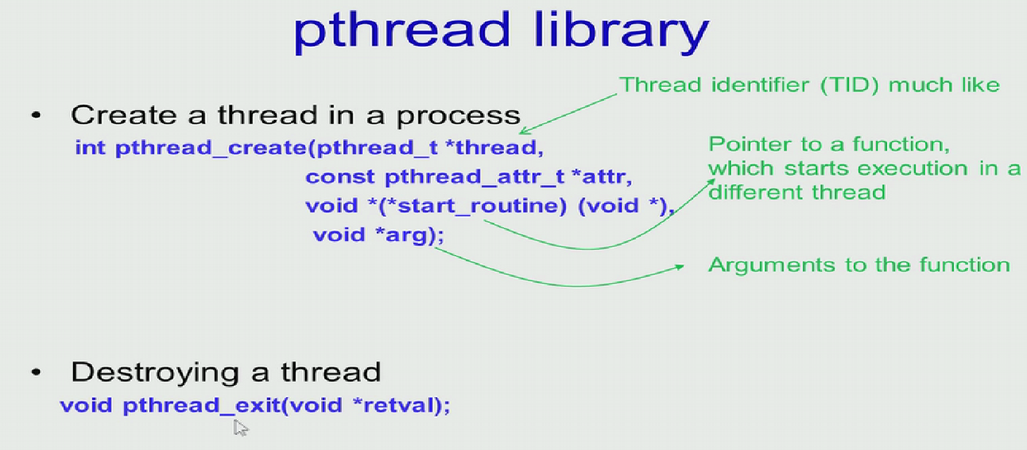
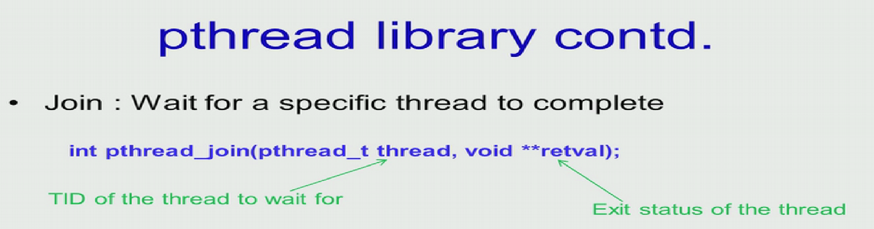
Ref.3

Slide 22
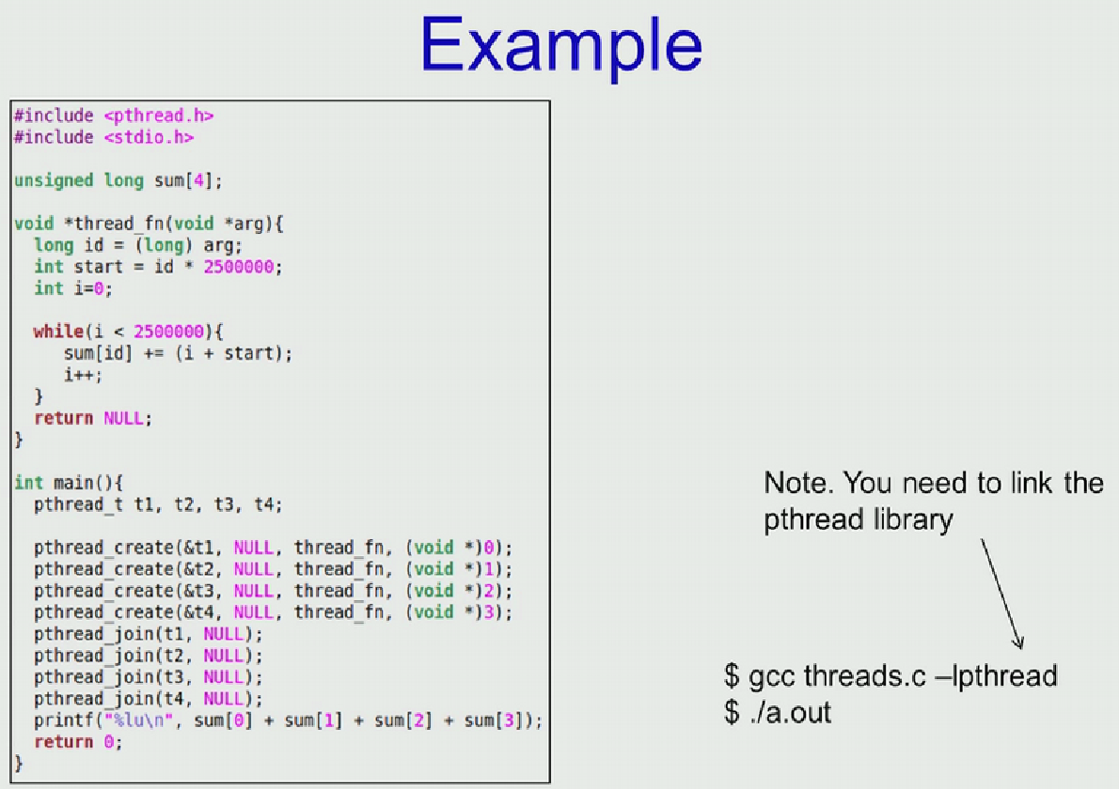

Slide 23
TERMINATING THREAD
#include <pthread.h>
void pthread_exit (return_value)
Threads terminate in one of the following conditions:
Completes function execution and return value
pthread_cancel() request received by thread
Thread initiates termination
The process of the threads terminates

Slide 24
THREAD CANCELLATION
pthread_cancel() : Terminates a thread before it has completed its execution
Whether thread cancel or not depends in its state and type
States
PTHREAD_CANCEL_DISABLE: Thread can not be cancelled.
PTHREAD_CANCEL_ENABLE: This is default state. Thread can be cancelled

Slide 25
THREAD CANCELLATION
Two types of thread cancellation
Asynchronous cancellation: terminates the target thread immediately
PTHREAD_CANCEL_ASYNCHRONOUS
Deferred cancellation allows the target thread to periodically check if it should be cancelled
PTHREAD_CANCEL_DEFERRED: Cancel when thread reaches ‘cancellation point’

Slide 26
THREADING ISSUES
Use of fork() and exec() system calls
Signal handling
Thread pools
Thread safety
Thread-specific data

Slide 27
USE OF FORK() ,EXEC(), EXIT()
Does fork() duplicate only the calling thread or all threads?
Few unix OS keep two version of fork to have both the options.
Exec(): the program speciﬁed in the parameter to exec() will replace the entire process—including all threads
Recommendation: In a process of multiple threads use fork() only after exec()

Slide 28
SIGNAL HANDLING
Signals are used to notify about events to a process.
A signal handler is used to process signals in the following way:
Signal is generated by particular event
Signal is delivered to a process
Signal is handled
Signal delivery options:
To the intended thread
To every thread in the intended process
To certain threads in the process
Assign a specific thread to receive all signals for the process

Slide 29
THREAD POOLS
Create and maintain a number of threads in a pool
Assign work to the threads as per the need
Faster method to handle a request using an existing thread instead of creating a new one
It bounds the number of threads in the application(s) to the size of the pool

Slide 30
THREAD SAFETY
A function is called thread-safe when it can be called by multiple threads at the same time without creating any disruptions.
Example of a function i.e. not safe:
static int glob = 0;
static void Incr (int loops)
{ int loc, j;
for (j = 0; j<loops; j++ {
loc = glob;
loc++;
glob = loc;}
}
Employs global or static values that are shared by all threads

Slide 31
HOW TO ENSURE THREAD SAFETY?
Serialize the function: Keep the critical section of the code locked so that only one thread access it at a time other threads out
Use only thread safe system functions
Avoid use of global and static variables

Slide 32
THREAD SPECIFIC DATA
Makes existing functions thread-safe .
May be slightly less efficient than being reentrant
Allows each thread to have its own copy of data
Provides per-thread storage for a function
Useful when you do not have control over the thread creation process (i.e., when using a thread pool)

Slide 33
THREADS: Pros and Cons
Advantages of multithreading
Easy to share resources and faster to create
Disadvantages of multithreading
Compete for acquiring memory
Ensure threads-safety
Error in one can disrupt the execution of other threads due to sharing of resources
Considerations for future design
Handling signals is tricky
All threads must run the same program

Slide 34
OPERATING SYSTEM EXAMPLES
Windows XP Threads
Linux Thread
Notes:
‹#›

Slide 35
WINDOWS XP THREADS
It implements one-to-one mapping of threads with kernel-level
Each thread contains
A unique thread id
Set of Registers
Separate user and kernel stacks
Private data storage area
These are called context of the threads
The primary data structures of a thread include:
ETHREAD (executive thread block)
KTHREAD (kernel thread block)
TEB (thread environment block)

Slide 36
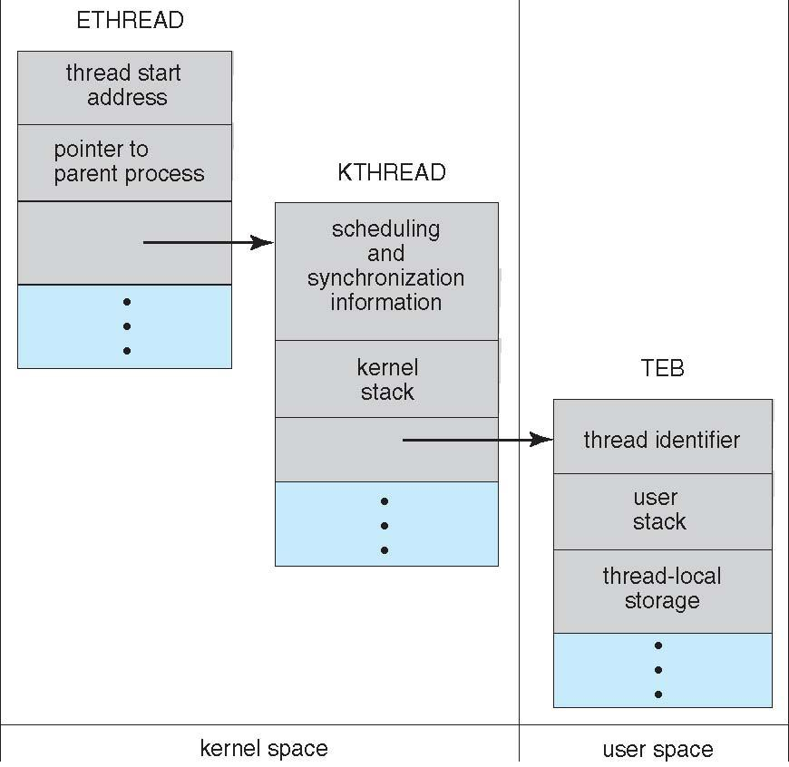
WINDOWS XP THREADS

Slide 37
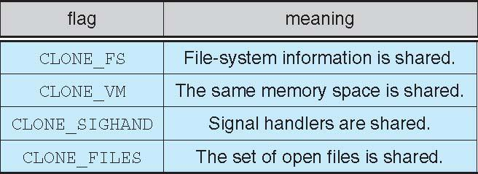
LINUX THREADS
Threads are referred as Tasks in Linux
Tasks are created using clone() system call
clone() allows a child task to share the address space of the parent task (process)

